Slide 1
Coordination, Regulation and Transport of Proteins

Slide 2
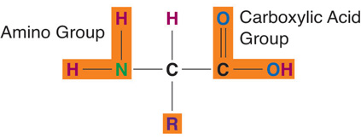
What Is Protein?
Proteins are macromolecules composed of amino acids.
Amino acids are commonly called protein’s building blocks.
Proteins contain the elements carbon, hydrogen, and oxygen and proteins are the only macronutrient that contains nitrogen.
In each amino acid the elements are arranged into a specific conformation around a carbon center.
Each amino acid consists of a central carbon atom connected to a side chain, a hydrogen, a nitrogen-containing amino group, a carboxylic acid group—hence the name “amino acid.”
Amino acids differ from each other by which specific side chain is bonded to the carbon center.

Slide 3
Selective Transport of Proteins to
Organelles
Each organelle has proteins with specific functions.
Synthesis of most proteins begins in ribosomes in the cytoplasm.
The destination of each protein is determined by the selective signal sequence included in the amino acid sequence of the protein. This signal sequence binds to other proteins that are involved in transporting the target protein to a particular organelle.
Proteins without this signal sequence remain in the cytoplasm.
As shown in Figure 1. selective transport has three mechanisms.

Slide 4
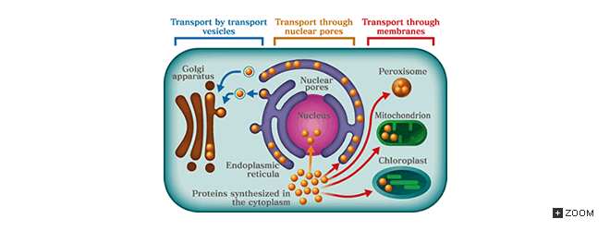
The first is the transport of proteins from the cytoplasm to the nucleus through holes in the nuclear envelope (nuclear pores).
The second is the transport of proteins from the cytoplasm to endoplasmic reticula, mitochondria, chloroplasts and peroxisomes, which is performed by protein translocators located in the membrane of organelles.
In this case, the higher order structure of proteins is unwound before passing through the membrane, and is folded back into its functional structure after passage.
The third mechanism is transport between membrane structures, which is performed by other small membrane structures known as transport vesicles.

Slide 5
Transport to and from the Nucleus
The nuclear envelope that houses the DNA-containing nucleus consists of two lipid bilayers (the inner and outer membranes), and gateways known as nuclear pores cross the envelope (Fig. 1).
Although DNA replication and DNA transcription into RNA occur in the nucleus, protein translation by ribosomes occurs in the cytoplasm.
Transcribed RNA is therefore carried through the nuclear pores to the outside of the nucleus.
Conversely, proteins involved in replication and transcription - such as enzymes and transcription factors - are transported into the nucleus through the nuclear pores after being synthesized in the cytoplasm.

Slide 6
Transport of Proteins to Mitochondria and Chloroplasts
Each protein synthesized in ribosomes within the cytoplasm and then transported to mitochondria or chloroplasts has a selective signal sequence.
When the signal sequence of Protein A is replaced with that of Protein B in experimental genetic engineering conditions, Protein A is transported to a different organelle to which Protein B is supposed to be transported, indicating that the signal sequence determines the destination of proteins in the cell.
When proteins are transported to mitochondria or chloroplasts, their structure is unwound before passing through the outer membrane of the organelle, and is folded back into its original functional structure once inside (Fig. 2).

Slide 7
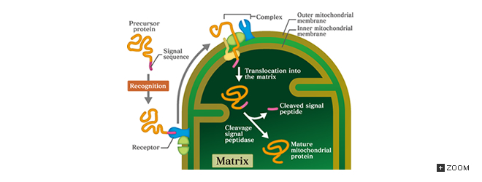

Slide 8
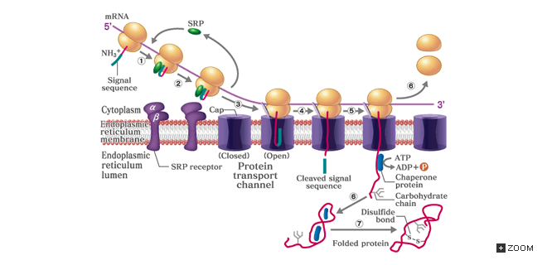
Transport of Proteins to Endoplasmic Reticula
Proteins incorporated into the plasma membrane, enzymes in lysosomes and proteins secreted to the outside of the cell are synthesized in ribosomes attached to the endoplasmic reticulum membrane.

Slide 9
Endoplasmic reticula with ribosomes attached are called rough endoplasmic reticula.
The synthesis of a protein starts in the cytoplasm; as soon as the signal sequence of the protein is synthesized, the protein complex (SRP) recognizes and attaches itself to the sequence, and the SRP-bonded protein attaches itself to the receptor on the endoplasmic reticulum membrane, where the synthesis of the protein continues (Fig. 3).
The protein about to be fully synthesized is transported into an endoplasmic reticulum through the protein transport channel.
In the endoplasmic reticulum, the protein, with the help of proteins called chaperones, is folded into a functional form.
A pair of cysteine side chains is oxidized to form a disulfide bond in the endoplasmic reticulum.
In addition, many membrane proteins and proteins secreted to the outside of the cell are covalently bonded with short oligosaccharide chains.

Slide 10
Vesicular Transport
Transport vesicles are used for the transport of membrane components and secretory proteins and for the incorporation of materials. This is known as vesicular transport (Fig. 4).
A transport vesicle is first formed as a pit undercoated with coat proteins (Fig. 4) in a phenomenon known as budding.
The proteins to be transported are enveloped inside the budding vesicle, which is then cut off from the endoplasmic reticulum to form a transport vesicle filled with baggage(proteins).
The transport vesicle, following the detachment of the coat proteins, is carried to its destination. The membrane of the transport vesicle has a protein called SNARE, which bonds with a particular SNARE protein on the target membrane. The destination of a transport vesicle is therefore determined by the type of SNARE protein it has.

Slide 11
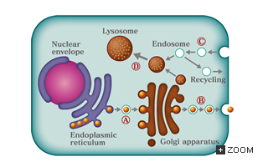
Transport vesicles supply the lipids and proteins of the plasma membrane from an endoplasmic reticulum to a Golgi apparatus (5A) and from a Golgi apparatus to the plasma membrane (5B). When the transport vesicle is fused with the plasma membrane, proteins on the membrane stay on the cell surface, while those inside the transport vesicle are released to the outside of the cell.
A) From an endoplasmic reticulum to a Golgi apparatus,
B) From a Golgi apparatus to the plasma membrane,
C) From the plasma membrane to an endosome,
D) From an endosome to a lysosome

Slide 12
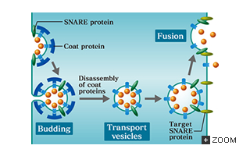

Slide 13
Incorporation Pathways of Extracellular Materials
Extracellular materials are incorporated through the three pathways shown in Figure. 6.
The first is, as already discussed, the direct transport of water-soluble ions and other materials to the cytoplasm by transporters or through channels in the plasma membrane.
The second pathway is called endocytosis, which involves part of the plasma membrane being incorporated into the cell in the form of transport vesicles enveloped by a coat protein called clathrin.
When this occurs, proteins and lipids attached to receptors on the plasma membrane are also incorporated into the vesicles. This is also the pathway mediated by transport vesicles (Fig. 5C).

Slide 14
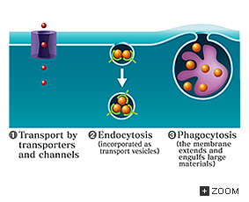
The endosomes incorporated into the cell gradually lower their pH through the action of proton pumps, are fused with lysosomes and break down the molecules incorporated (Fig. 5D). Some endosome proteins are then recycled to the plasma membrane.
The third pathway is called phagocytosis, in which large particles such as bacteria are engulfed, and the plasma membrane extends toward and surrounds the target articles by the action of the cytoskeleton elements such as actin. The vacuoles formed in the cell are fused with lysosomes, leading to the degradation of ingested articles.

